Slide 1
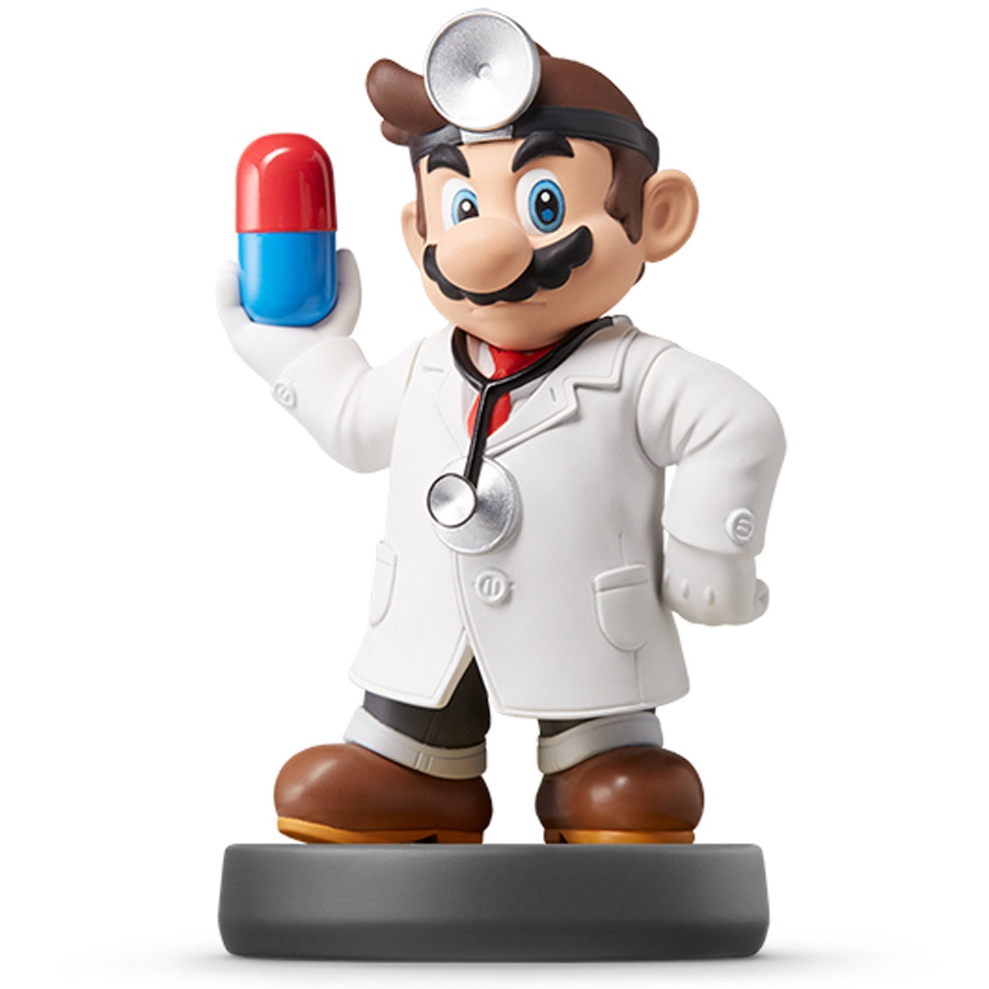
Welcome to the Show

Slide 2
Who am I?
Name: Mario Giacomazzo
Origin: Cleveland, OH
Undergrad: Baldwin-Wallace University
Grad: Arizona State University
Personal Website
Research Info

Slide 3
Who are you?
I Don’t Know
Roll Call

Slide 4
Why are We Here?
Data Science
Definition: The easiest part of research

Slide 5
What do I Need?
Textbook:
Computer: We will actively use our laptops in every class.
R and RStudio Installed and Operational
High Tolerance for Pain and Agony

Slide 6
What will We Do?
Course Website and Syllabus
Computer: We will actively use our laptops in every class.
R and RStudio Installed and Operational
High Tolerance for Pain and Agony
https://supermariogiacomazzo.github.io/STOR320_WEBSITE/

Slide 7
Today
Syllabus
Course Overview
Table of contents for R4DS
Getting R online
First ggplots

Slide 8
Course Website
https://ncdaddy.github.io/STOR_320/
All information for the course will be at the website above. Visit often, the address is also on the home page for our course on Sakai.

